Slide 1


Are
You
tired of rising inflation
?

Slide 2


Do
You
. . .
think our politicians
are useless
?
This Photo by Unknown Author is licensed under CC BY-SA

Slide 3
Yes
:(

Slide 4


Slide 5
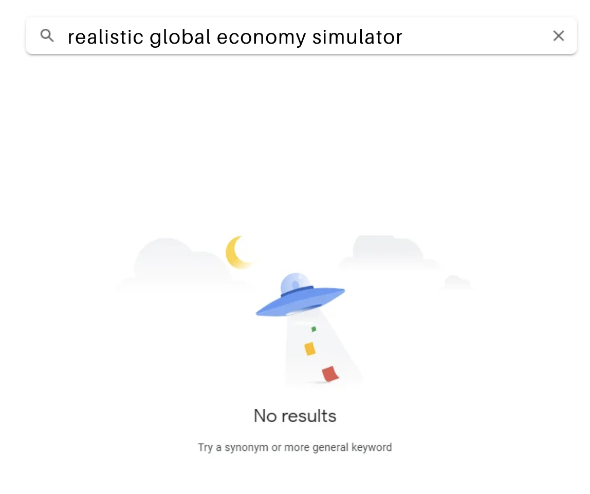

Slide 6
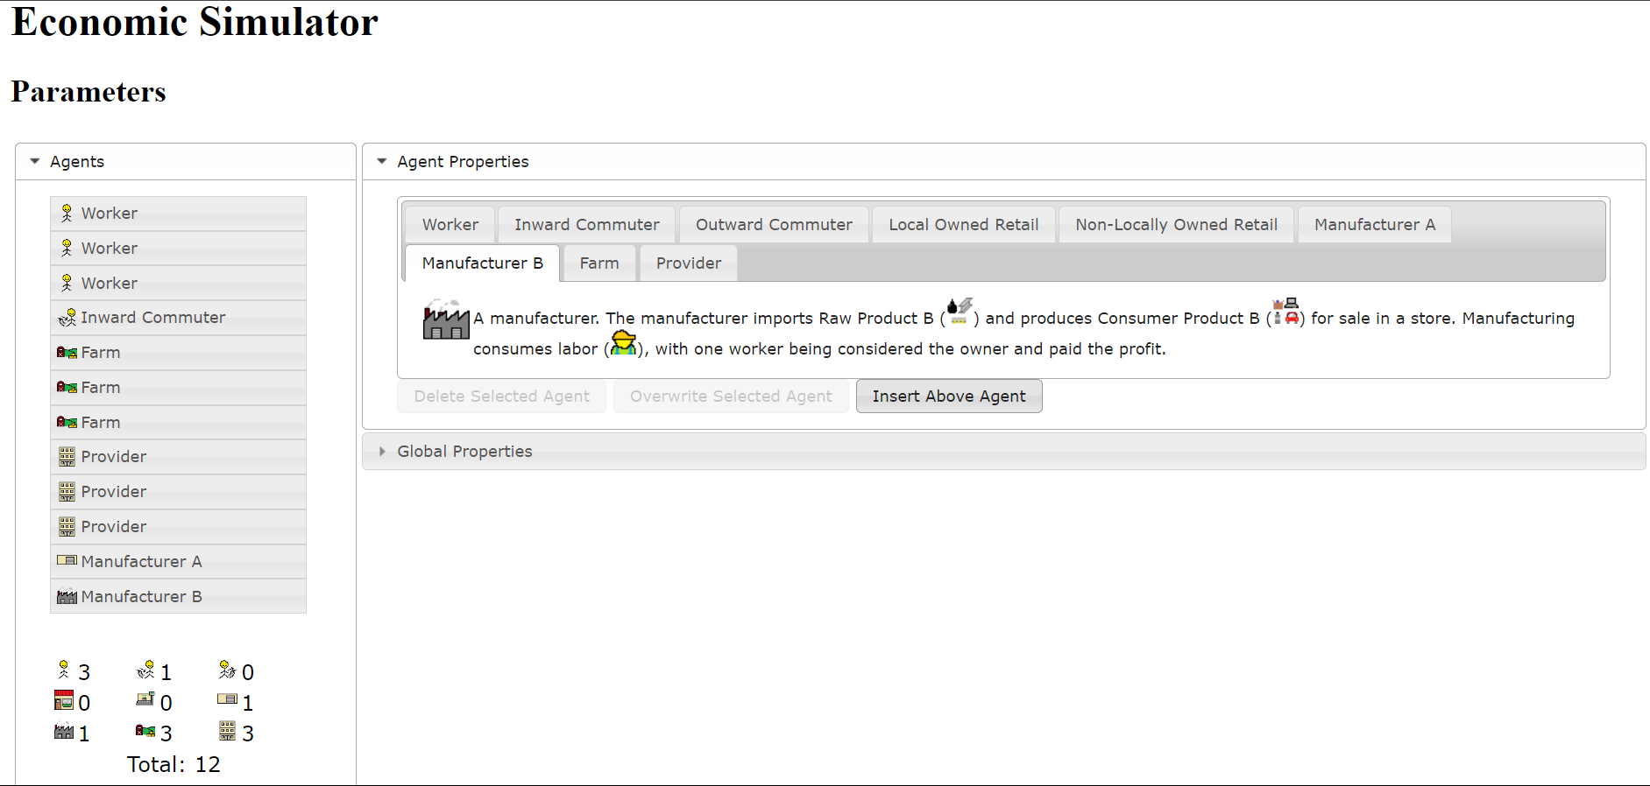
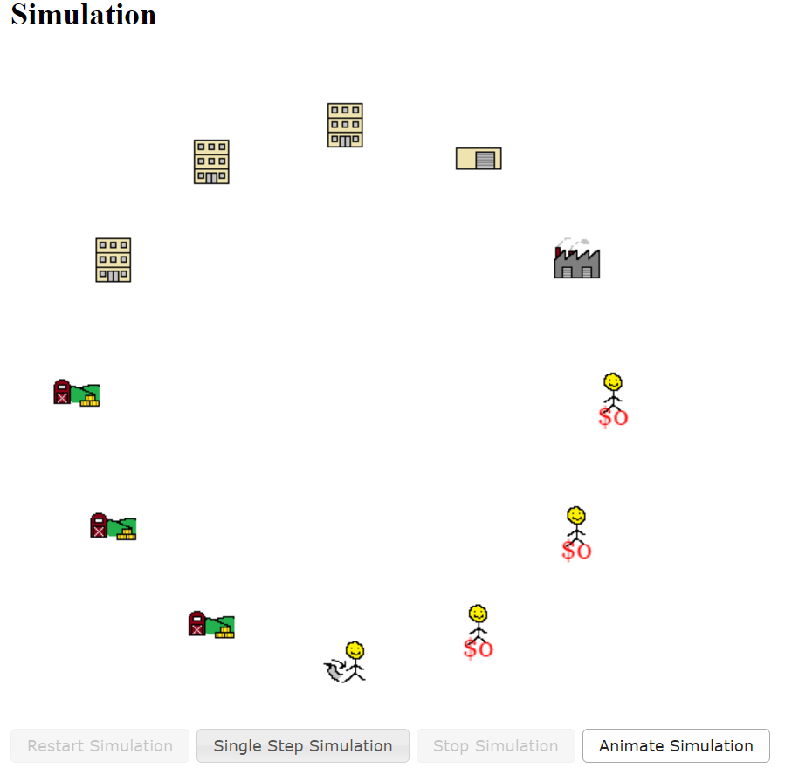
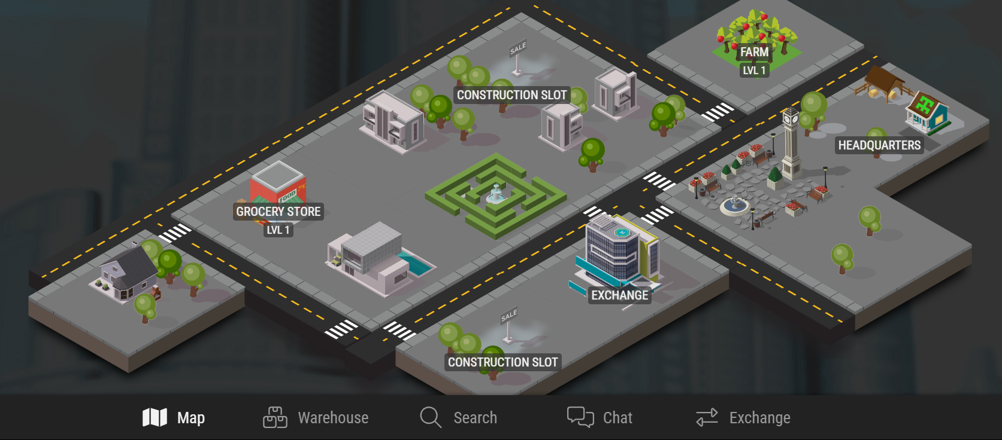

Slide 7

EconoQuake
Grace Im and Yuan Yin

Slide 8
So what is
EconoQuake
?

Slide 9



Slide 10

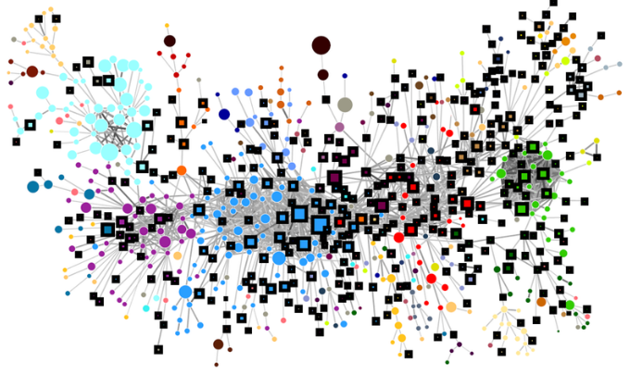
Current Circumstances
Difficulty experimenting with economics
Real-world economies are complex and unpredictable

Slide 11

Video Games
Video games are effective
89% agree helpful for learning
Teach the public economic concepts

Slide 12

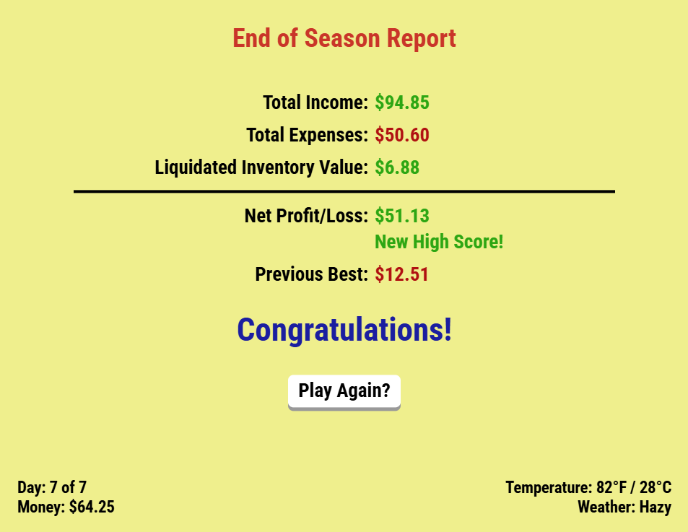
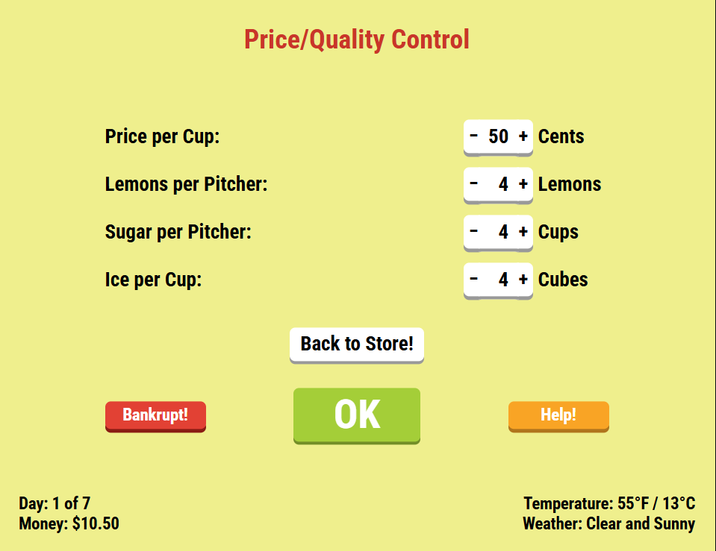

Slide 13
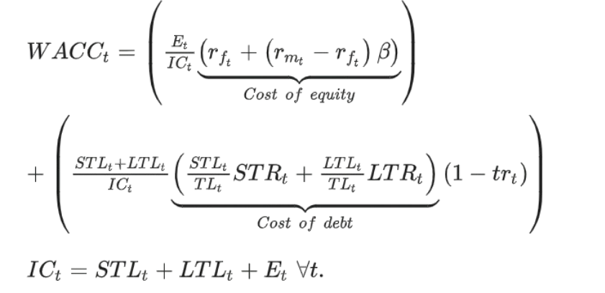
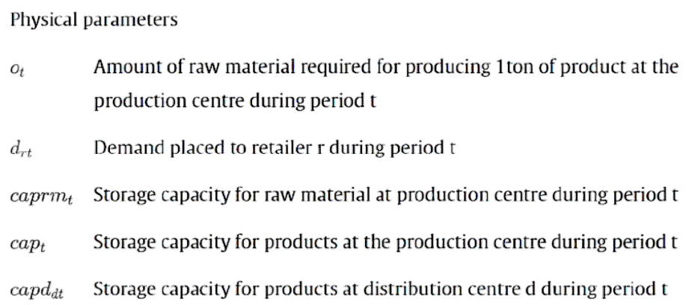
Not beginner friendly
Complex equations and vocab

Slide 14
Improvements

Slide 15
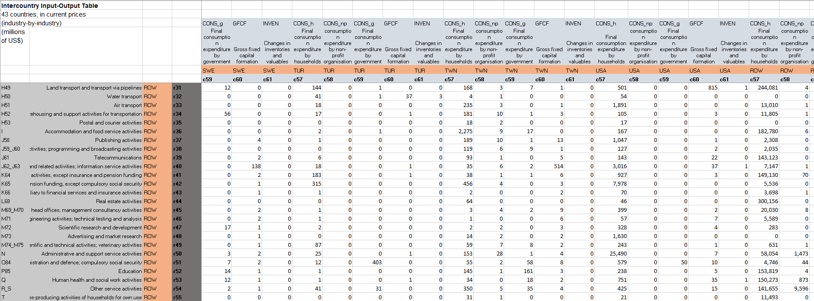
WIOD
43 Countries
2000 - 2014
56 Sectors

Slide 16


Equations
Multi Region Input Output (MRIO) model
X = (I – A$)^{−1}$y
Leontief input output function

Slide 17
Methods
Pymrio, Pandas Library
Flask App
HTML, JS, CSS

Slide 18
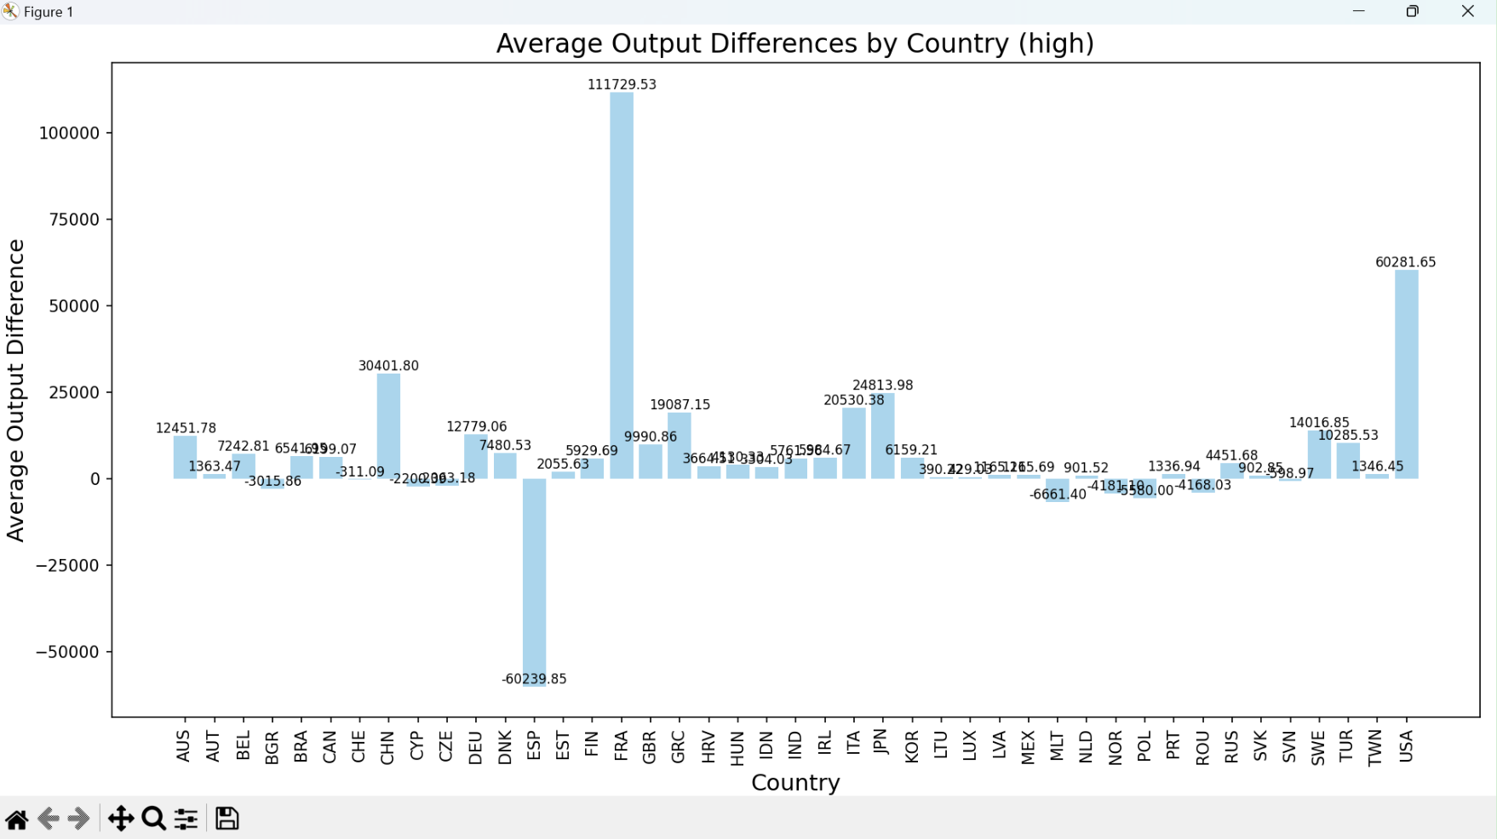

Slide 19
Interface
Country 1
GDP
Product descriptions
Country 2
Affected outputs and GDP

Slide 20
Live demo

Slide 21
Significance
Education
Economic Literacy
Concepts
Interactive Simulations

Slide 22
Future Plans
Design Alternatives
Gamification
2025
2026
2027
???
Market Caprice
Product Diversity

Slide 23
EconoQuake

Slide 24
References
Andrew, R. M., & Peters, G. P. (2013). A Multi-Region Input–Output Table Based on the Global Trade Analysis Project Database (gtap-Mrio). Economic Systems Research, 25(1), 99–121. https://doi.org/10.1080/09535314.2012.761953
Badakhshan, Ehsan & Ball, Peter. A simulation-optimization approach for integrating physical and financial flows in a supply chain under economic uncertainty, Operations Research Perspectives, Volume 10, 2023, 100270, ISSN 2214-7160, https://doi.org/10.1016/j.orp.2023.100270
Dietzenbacher, E., Los, B., Stehrer, R., Timmer, M., & de Vries, G. (2013). The Construction of World Input–Output Tables in the Wiod Project. Economic Systems Research, 25(1), 71–98. https://doi.org/10.1080/09535314.2012.761180
Jonkeren, O., & Giannopoulos, G. (2014). Analysing Critical Infrastructure Failure with a Resilience Inoperability Input–Output Model. Economic Systems Research, 26(1), 39–59. https://doi.org/10.1080/09535314.2013.872604
Koks, E. E., Rozenberg, J., Zorn, C., Tariverdi, M., Vousdoukas, M., Fraser, S. A., Hall, J. W., & Hallegatte, S. (2019). A global multi-hazard risk analysis of road and railway infrastructure assets. Nature Communications, 10(1), 2677. https://doi.org/10.1038/s41467-019-10442-3
Koks, E. E., & Thissen, M. (2016). A Multiregional Impact Assessment Model for disaster analysis. Economic Systems Research, 28(4), 429–449. https://doi.org/10.1080/09535314.2016.1232701
Lenzen, M., Moran, D., Kanemoto, K., & Geschke, A. (2013). Building Eora: A Global Multi-Region Input–Output Database at High Country and Sector Resolution. Economic Systems Research, 25(1), 20–49. https://doi.org/10.1080/09535314.2013.769938

Slide 25
References
Leontief, W. (1986). Input-output Economics. Oxford University Press.
Lutter, S., Pfister, S., Giljum, S., Wieland, H., & Mutel, C. (2016). Spatially explicit assessment of water embodied in European trade: A product-level multi-regional input-output analysis. Global Environmental Change, 38, 171–182. https://doi.org/10.1016/j.gloenvcha.2016.03.001
Nungesser, S. L., & Pauliuk, S. (2022). Modelling Hazard for Tailings Dam Failures at Copper Mines in Global Supply Chains. Resources, 11(10), Article 10. https://doi.org/10.3390/resources11100095
Sierra, Javier & Rodríguez-Conde, Maria J. Learning by ruling: Use of videogames to simulate public economics management, The International Journal of Management Education, Volume 21, Issue 2, 2023, 100819, ISSN 1472-8117, https://doi.org/10.1016/j.ijme.2023.100819
Sun, Y., Zhu, S., Wang, D., Duan, J., Lu, H., Yin, H., Tan, C., Zhang, L., Zhao, M., Cai, W., Wang, Y., Hu, Y., Tao, S., & Guan, D. (2024). Global supply chains amplify economic costs of future extreme heat risk. Nature, 627(8005), 797–804. https://doi.org/10.1038/s41586-024-07147-z
Verschuur, J., Fernández-Pérez, A., Mühlhofer, E., Nirandjan, S., Borgomeo, E., Becher, O., Voskaki, A., Oughton, E. J., Stankovski, A., Greco, S. F., Koks, E. E., Pant, R., & Hall, J. W. (2024). Quantifying climate risks to infrastructure systems: A comparative review of developments across infrastructure sectors. PLOS Climate, 3(4), e0000331. https://doi.org/10.1371/journal.pclm.0000331
Wieland, H., & Giljum, S. (2016). Carbon footprint decomposition in MRIO models: Identifying EU supply-chain hot spots and their structural changes over time. Ecological Economic Papers, Article 13. https://ideas.repec.org//p/wiw/wus045/5310.html

Slide 26
Thanks!
Do you have any questions?
Please keep this slide for attribution

